Slide 1
Chapter 7:
SOFTWARE CONFIGURATION MANAGEMENT
(4 Hrs)
Presented by
Er.Harendra Bikram Shah
Lecturer
Department of Computer Engineering
NAST

Slide 2
OUTLINES
7.1 Software Configuration Items
7.2 Configuration Management Activities
7.2.1 Change Management
7.2.2 Version Management
7.2.3 System Building
7.2.4 System Release

Slide 3
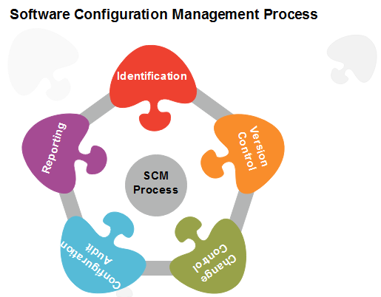
Software Configuration Management(SCM)
It is a process to systematically manage, organize, and control the changes in the documents, codes, and other entities during the Software Development Life Cycle.
Processes/Task involved in SCM
1. Identification and Establishment
2. Version control
3. Change control
4. Configuration auditing
5. Reporting

Slide 4
Importance of Software Configuration Management
Effective Bug Tracking:
Continuous Deployment and Integration:
Risk management:
Support for Big Projects:
Reproducibility:
Parallel Development:
Need for System configuration management
Replicability:
Identification of Configuration:
Effective Process of Development:

Slide 5
Key objectives of SCM
Control the evolution of software systems:
Enable collaboration and coordination:
Provide version control:
Facilitate replication and distribution:
SCM is a critical component of software Development.
The main advantages of SCM
Improved productivity and efficiency
Reduced risk of errors and defects
Increased collaboration and communication among team members
Improved quality and stability of software systems
The main disadvantages of SCM
Increased complexity and overhead
Difficulty in managing dependencies and ensuring that all changes are properly integrated.
Potential for conflicts and delays.

Slide 6
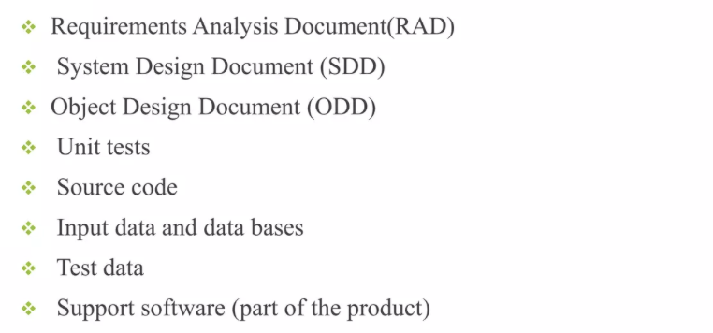
Software Configuration Items
Software Configuration Item is information that is created as part of the software engineering process.

Slide 7
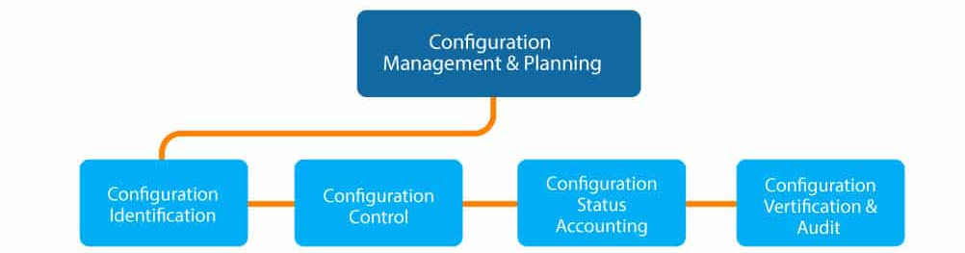
Configuration Management
Art of identifying organizing and controlling Modifications to the software being built by a programming team.
The goal is to maximize productivity by minimizing mistakes

Slide 8
Configuration Management Activities
1. Change Management
Ensure that all changes to a system are controlled, evaluated, and tracked to maintain stability and traceability.
Activities:
  Recording change requests and assigning priorities.
  Impact analysis to assess potential consequences of changes.
  Approving or rejecting changes based on the analysis.
  Implementing approved changes while minimizing disruptions.
  Maintaining documentation to track all changes and their effects.
2. Version Management
Control versions of software artifacts (e.g., source code, documentation) to avoid conflicts and ensure consistency.
Activities:
  Assigning version identifiers to each release or update.
  Maintaining a repository to store and track versions of files.
  Supporting branching and merging for parallel development efforts.
  Providing version history to enable rollback if necessary.

Slide 9
Configuration Management Activities
3. System Building
Automate the process of compiling, linking, and integrating system components to create a working system.
Activities:
  Defining build scripts and tools to automate the build process.
  Integrating modules and ensuring compatibility between components.
  Running automated tests during the build process to verify system functionality.
  Detecting and resolving build errors early in development.
4. System Release
Plan, package, and deliver a stable system version to users or customers.
Activities:
  Preparing release documentation, including release notes and user guides.
  Creating installation packages or deploying the system to production.
  Ensuring the system meets quality assurance standards.
  Managing the release schedule and coordinating with stakeholders.

Slide 10
End of The Unit

Slide 11
THANK YOU

